Slide 1


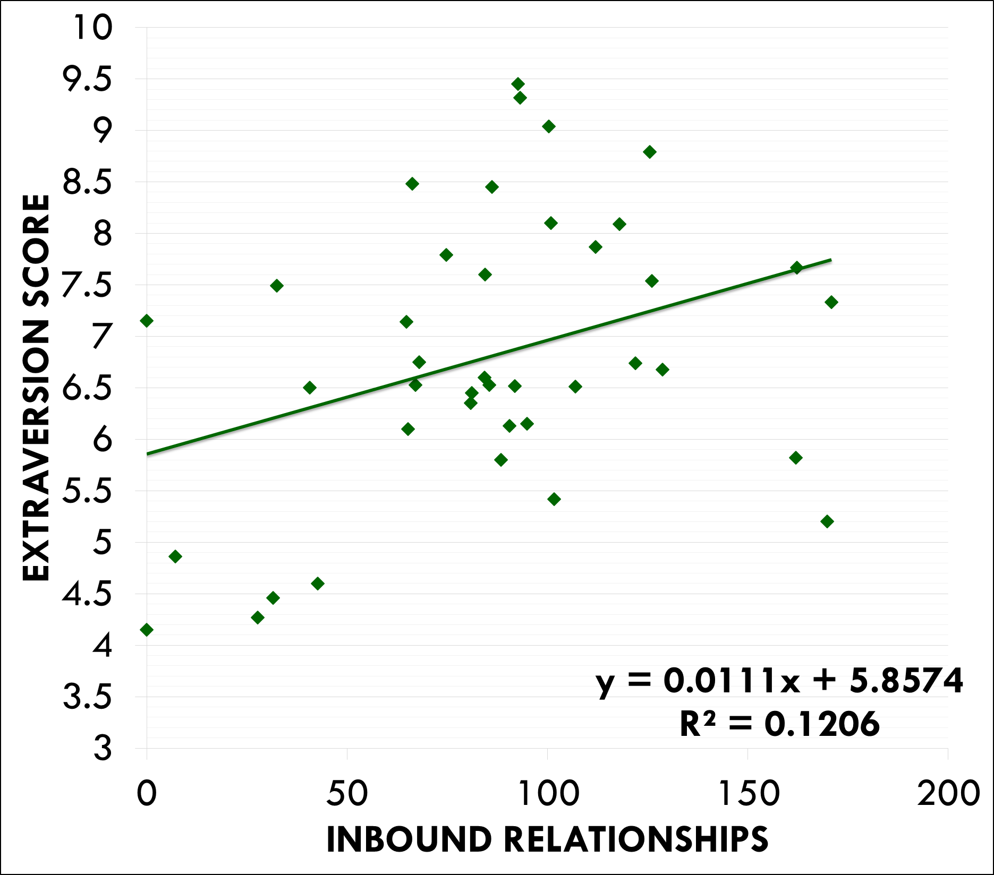
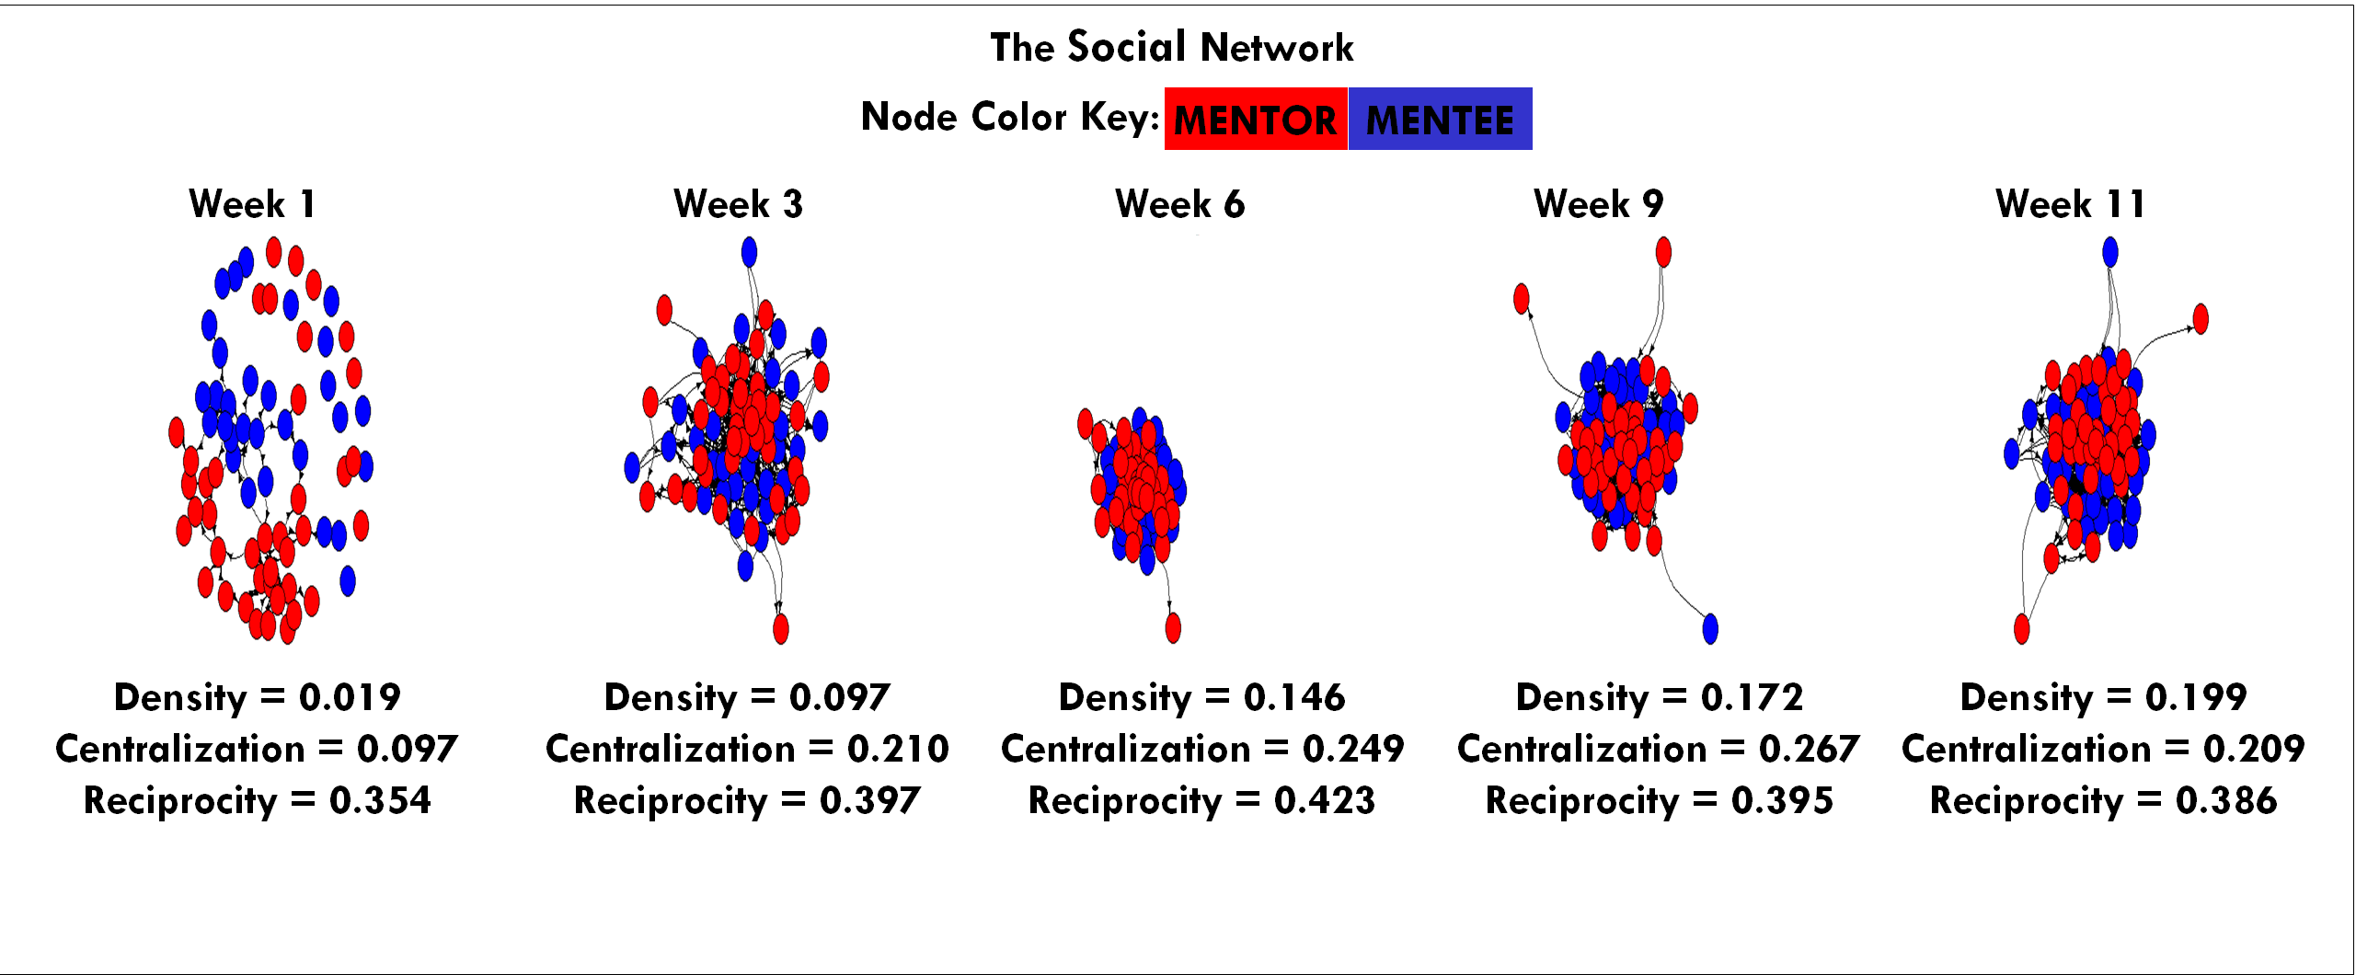
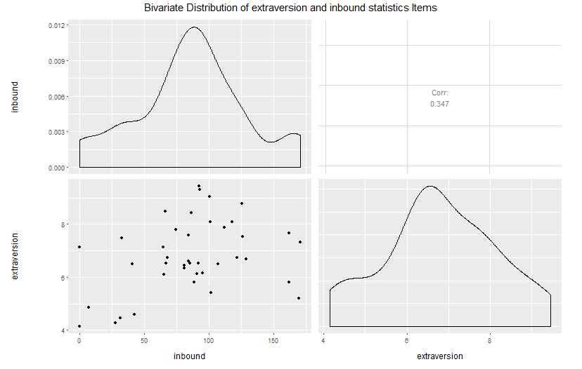
Extraversion Correlations
Personality and the Evolution of Mentor Social Networks in a Mentoring Program for At-Risk youth
Neil Yetz, BA^{1,2} Shelley Haddock, PhD³ & Kimberly Henry, PhD^{1,2}
1. Colorado School of Public Health; 2. Colorado State University Department of Psychology ;
3. Colorado State University Department of Human Development & Family Studies
Introduction
Methods
Summary
Campus Connections is a multidisciplinary service learning course at CSU where undergraduate students serve as mentors to youth. Students from over 65 different majors work one on one with youth ranging in age from 11-18 who are referred to Campus Connections from our community partners (juvenile justice system of Larimer County, local schools, social service agencies) and directly from families. Student mentors spend four hours once a week with their mentee in a group setting to provide academic support and career planning, encourage positive social skill development, assist with goal setting, and implement wellness programming. Strong bonds are developed over the 12 week program between mentors and mentees
The evolution of the social network of mentors and mentees is tracked as part of the evaluation of Campus Connections. Here, we chart the network over the course of the intervention, and examine the extent to which mentor extraversion is associated with the number of social network nominations that they receive.
Social network data was collected during the fall 2015 semester for one Campus Connections session. Staff (N=40) and mentee’s (N=30) were asked to choose individuals on a survey that they felt a connection with and then asked to rate the strength of the corresponding relationship. The social network data was assessed for the Campus Connections program at weeks 1, 3, 6, 9, and 11. For each week, measures of density, centralization & reciprocity were assessed.
All mentor staff within the social network reported personality characteristics via the Hexaco 60-item Personality Inventory (Ashton & Lee, 2009).
Hypothesis 1: An increase in social bonds would be seen across the 12-week program.
Hypothesis 2: Higher scores in extraversion would be associated with a higher number of relationships among mentors.
Results show a steady increase in social network density over the 12 week Campus Connections mentorship program.
Mentors who scored higher on measures of extraversion tended to have more inbound relationship nominations between fellow staff and mentees (r=0.34 [0.04-0.59], p=0.028).
Previous research finds inconsistencies in the association between extraversion and social network bonds (Fang et al, 2015). In this study, we find that extroverted mentors tend to receive more (and stronger) friendship nominations. If, in subsequent analyses, we find that mentors who become more embedded in the social network are more effective in their role, then selecting mentors based on extraversion may be a viable mechanism for enhancing program effects.
Methods
Results
Hypotheses
Out | Hhumility
 | Extraversion
 | Emotionality
 | Agreeableness
 | Openness
 | Conscientiousness
Ashton, M. C., & Lee, K. (2009). The HEXACO-60: A short measure of the major dimensions of personality. Journal of Personality Assessment, 91, 340-345.
Fang R, Landis B, Zhang Z, Anderson, MH, Shaw, JD, & Kilduff M (2015). Integrating personality and social networks: A meta-Analysis of personality, network position, and work outcomes in organizations. Organization Science. 26(4) 1243-1260.

